Slide 1
Supply chain
M3 - Feature Engineering

Slide 2
Label Encoding for ordinal categorical columns
Approved warehouse govt certificate :
grade order = ['C','B','B+','A','A+']
Encoded = [0, 1, 2, 3, 4]
warehouse capacity size
Size = ['Small', 'Mid', 'Large']
Encoded = ['0','1',2]
warehouse regional zone
Zones : [ zone 1, zone 2, zone 3, zone 4, zone 5, zone 6]
Encoded only numbers from zones : [1, 2, 3 ,4 ,5, 6]
ONE HOT ENCODING FOR NON ORDINAL
Location type : [Urban,Rural]
Zone : [north, east ,west ,south]
Wh_owner_type ; [rented, company owned]

Slide 3
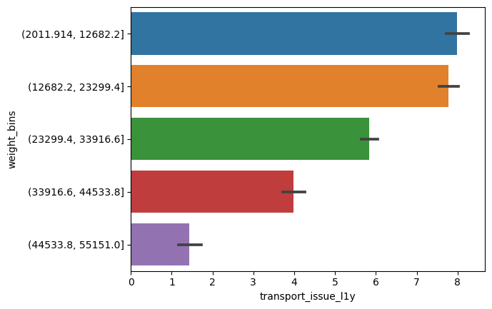
Transport issue in last 1 year after grouping
Weight bins​ (2011.914, 12682.2] 4427.0​ (12682.2, 23299.4] 5161.0​ (23299.4, 33916.6] 3956.5​ (33916.6, 44533.8] 919.0​ (44533.8, 55151.0] 127.5

Slide 4
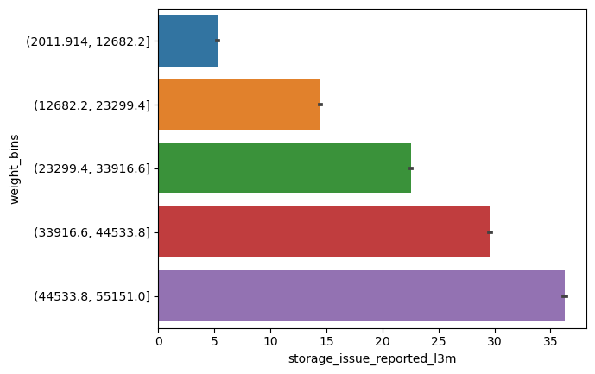
Storage issues in last 3 months

Slide 5
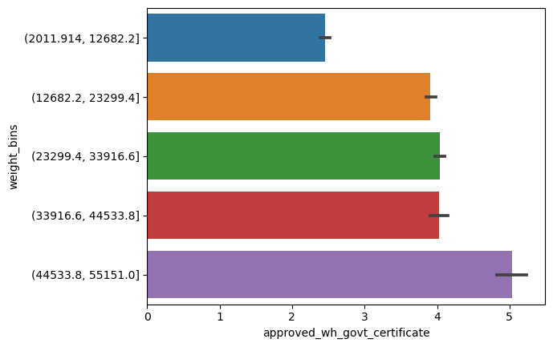
Approved govt certificate

Slide 6
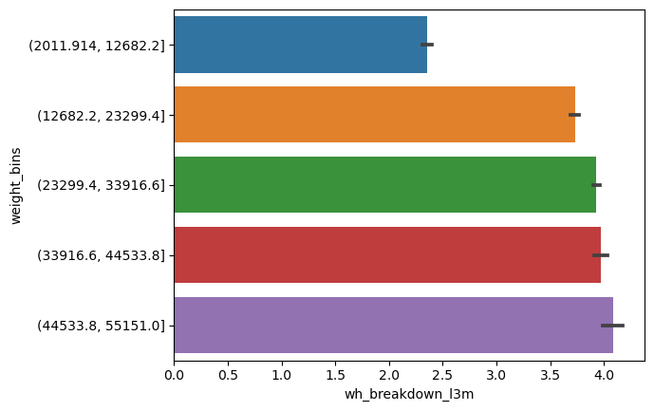
Warehouse breakdown in last 3 months

Slide 7
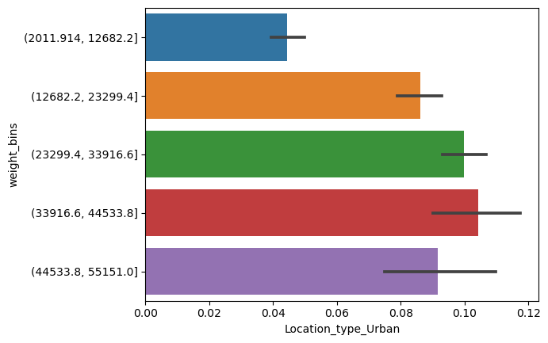
Warehouse location type

Slide 8
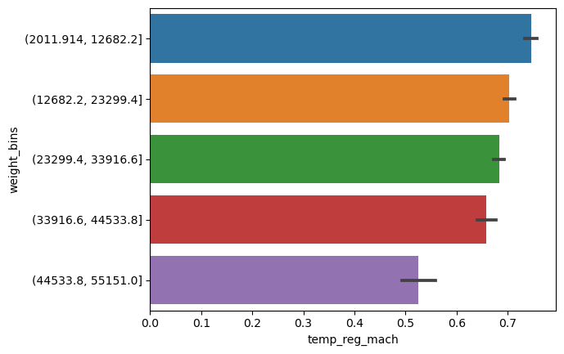

Temperature regulating machine(1,0)

Slide 9
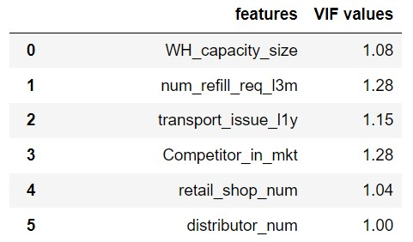
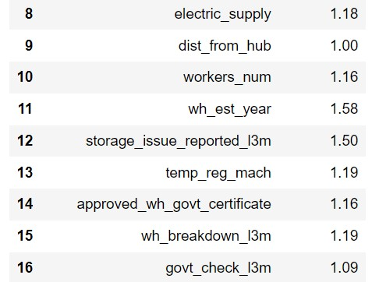
VIF to determine multicollinearity
Only for continuous features
As VIF is less than 5 , no multicollinearity

Slide 10
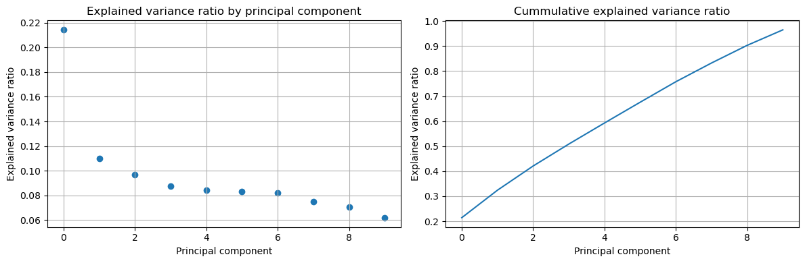
PCA for all above continuous variables
Explained Variance ratio after PCA is : [0.21425898 0.32408202 0.42075348 0.5084688 0.59269618 0.67566088 .75751909 0.83245014 0.90301638 0.96491989]

Slide 11
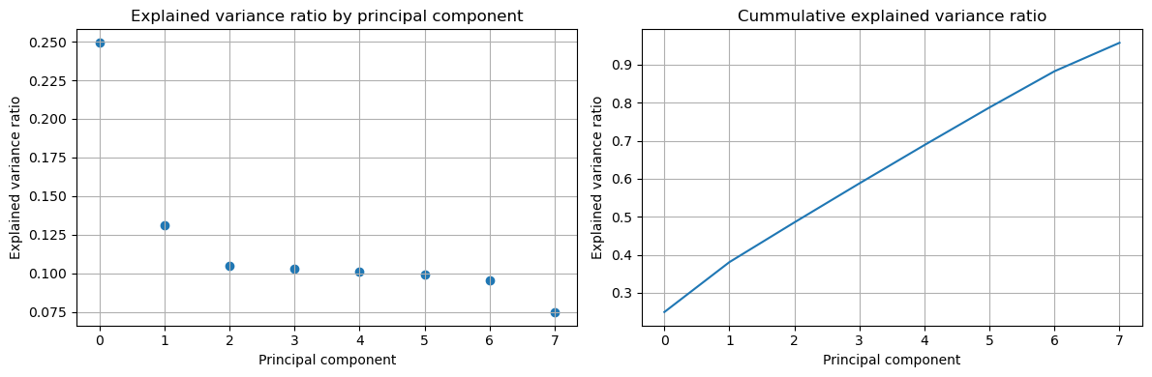
PCA after removing two variables:('approved_wh_govt_certificate','WH_capacity_size')
Explained Variance ratio after PCA is : [0.24925923, 0.38061111, 0.48524138, 0.58790771, 0.68877564 , 0.78765954, 0.88297611, 0.95783167]

